Slide 1
Medical Chatbot Development: Utilizing Knowledge Graph & Machine Learning Techniques
19CCE495 : Project phase 1
TEAM ID : ECE013
Project Advisor : Ms. Prabha G

Slide 2
Team Members
Name of the student | Roll Number
Lakshmikanth Reddy B | CB.EN.U4CCE20011
Sohith Reddy CH | CB.EN.U4CCE20012
Sai Tarun D | CB.EN.U4CCE20014
Gowtham Kumar Y | CB.EN.U4CCE20073

Slide 3
Objectives
To implement web scraping techniques to gather related medical data from various sources & data cleaning.
Enhancing and testing the Knowledge graph and building a baseline structure.
To develop a question-answering system with the developed knowledge graph in integration with the front-end developed website.
To assess the effectiveness of the created chatbot using various metrics.

Slide 4
Introduction
Challenges in manual medical interrogation system include imbalanced allocation of medical resources, population growth, and the rise of online medical question-and-answer chaos.
To address these issues, a Knowledge Graph-based Q.A. system is leveraging reliable medical data for improved interrogation services.
The need for smart care solutions to address the evolving care needs of the growing elderly population.

Slide 5
Problem Statement
To construct a question answering Chatbot that can answer user’s queries based on the information available in Knowledge graph and provide sufficient information regarding medical issues.

Slide 6
Motivation
If a patient wants information about a disease, they need to search for relevant content on the internet and find answers by clicking the URL's provided by internet.
Construction of such Chatbot can help the user find answers to his queries easily and know every aspect of the disease or anything regarding the disease.
The project is driven by the key motivations which are Enhanced Information Retrieval, Contextual Understanding, Evidence-Based Decision Making, Empowering Patients.

Slide 7
Novelty
The existing systems has limited interactivity with the chatbot. In our project we would like the user to have maximum understanding of the system using a user friendly website where they can directly either chat or visualize the graph relations between diseases and their attributes with easy accessibility.

Slide 8
Milestones
Review | Month | Milestone
1 | Sep 2023 | Literature Survey Data Scraping
2 | Oct 2023 | Data Cleaning & Data Translation
3 | Nov 2023 | Enhancing & testing the knowledge graph Building a baseline structure
4 | Jan 2024 | Integration of chatbot with developed knowledge graph technique
5 | Feb 2024 | Development of front-end website
6 | Mar 2024 | Paper Draft
7 | May 2024 | Draft of Report
8 | Jun/Jul 2024 | Project Completion & Documentation of final report

Slide 9
Literature Survey
Title of the paper | Year | Authors | Publication | Comments | Advantages | Drawbacks
A Novel web scraping approach using the additional information obtained from web pages | 2020 | Erdinc Uzun | IEEE Access | How to understand a complicated website. Studies related to different web scraping techniques. Technique used: UzunExt. | Improving time efficiency of data extraction. Exceptional speed will increases. Minimal code overhead. | Handling of Complex HTML Structures. Vulnerability to HTML Changes. Versatility Across Websites.
COVID-Scraper: An Open-Source Toolset for Automatically Scraping and Processing Global Multi-Scale Spatiotemporal COVID-19 Records | 2021 | HAI LAN , DEXUAN SHA ANUSHA SRIRENGANATH MALARVIZHI, YI LIU | IEEE Access | This paper mainly focuses on how to scrap data from different sources dealing with structured and unstructured data | Developed a tools for scraping which is very much flexible and scalable. | The data quality control and validation is not fully automated because accuracy is not guaranteed.

Slide 10
Cont..
Title of the paper | Year | Authors | Publication | Comments | Advantages | Drawbacks
A Survey on Knowledge Graphs: Representation, Acquisition, and Applications | 2021 | Shaoxiong Ji , Shirui Pan, Pekka Marttinen , and Philip S. Yu | IEEE TRANSACTIONS ON NEURAL NETWORKS AND LEARNING SYSTEMS | The paper's strength lies in its thorough coverage of recent advancements and emerging trends in knowledge graph research. | Comprehensive Review of Knowledge Graph Research Structured Categorization and Taxonomies | Complexity and Accessibility of Advanced Topics. Potential Lack of Specific Focus.
Research on medical question answering system based on knowledge graph | 2021 | Zhhixue Jiang, Chengying Chi, And Yunyun Ahan | IEEE Access | An detailed explanation & experiment based on knowledge graph & also query Q&A system. | A Detailed Research on Knowledge graph and question answering system was given. | The attribute from the data are very less only drug , symptom and disease names are considered so accuracy low.

Slide 11
Cont..
Title of the paper | Year | Authors | Publication | Comments | Advantages | Drawbacks
Towards electronic health record-based medical knowledge graph construction, completion, and applications: A literature study. | 2023 | Lino Murali a,c , G. Gopakumar b , Daleesha M. Viswanathan c , Prema Nedungadi | Elsevier Journal of Bio medical information's | The use of medical knowledge graphs has the potential to improve healthcare outcomes by extracting new links and hidden patterns from health data sources. Challenges faced during construction of EHR- based knowledge graph. | Different approaches of creating medical knowledge graph and their applications. | Some EHR being physical & unstructured can be a challenging in collection of data.
Complex Knowledge Base Question Answering: A Survey | 2022 | Yunshi Lan, Gaole He , Jinhao Jiang, Jing Jiang, Wayne Xin Zhao | IEEE TRANSACTIONS ON KNOWLEDGE AND DATA ENGINEERING | Overview of recent methods in KBQA with a focus on solving complex questions. Key challenges that arise when answering such complex questions. Technique used: SP and IR | SP: Interpretability Robustness Expressiveness IR: Efficiency Flexibility | SP: Computationally expensive IR: Robustness Expressiveness
Design and Development of We-CDSS Using Django Framework: Conducing Predictive and Prescriptive Analytics for Coronary Artery Disease | 2022 | DIVYASHREE N. , (Member, IEEE), AND NANDINI PRASAD K. S., (Senior Member, IEEE) | IEEE Access | This paper is mainly taken into consideration to understand the concepts of Django framework | Accessibility Security features User - friendly | Learning curve Upgrades and compatibility

Slide 12
Cont..
Title of the paper | Year | Authors | Publication | Comments | Advantages | Drawbacks
Question Answering Over Knowledge Graphs: A Case Study in Tourism | 2022 | Sereh Aghaei, Elie Raad, And Anna Fesnel | IEEE Access | Aims to provide answers to natural language questions (NLQs) using KGs. This paper proposes a two-phase approach to QA-KG for small and medium-sized KGs. | More scalable More accurate More flexible | Time-consuming process Over fitting
Knowledge Graph for China’s Genealogy | 2021 | Xindong Wu , Fellow, IEEE, Tingting Jiang Yi Zhu , and Chenyang Bu | IEEE TRANSACTIONS ON KNOWLEDGE AND DATA ENGINEERING | This paper focuses on the development of a genealogical knowledge graph model called Huapu-Kg and utilize genealogical knowledge graphs. | Structured data representation Query and analysis Integration of AI Feasibility validation | Data quality integration Scalability Complexity Expertise requirements
Automated clinical knowledge graph generation framework for evidence based medicine | 2023 | Fakhare Alam a , Hamed Babaei Giglou b , Khalid Mahmood Malik a | Elsevier Journal Expert systems with applications | Proposes a topic specific, PICO enabled, and fully automated framework to curate information and create KG of different clinical domains. | Building a knowledge graph according to requirements by using PICO framework are remarkable. | The knowledge graph is built according to the 2 data sets which are considered so they are limited to an extent along with the relations of the KG.

Slide 13
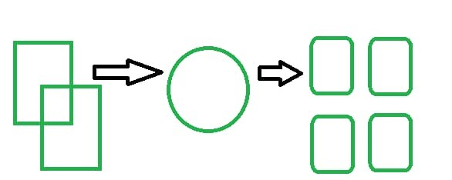
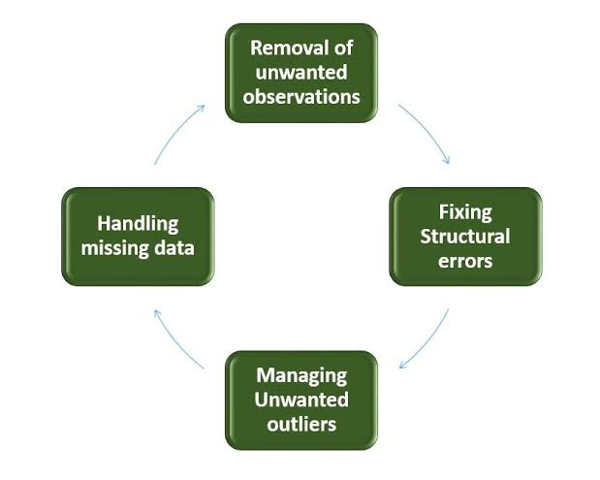
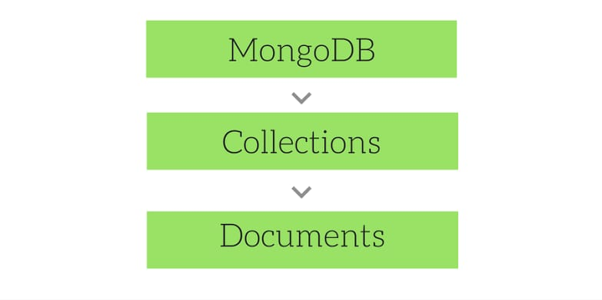
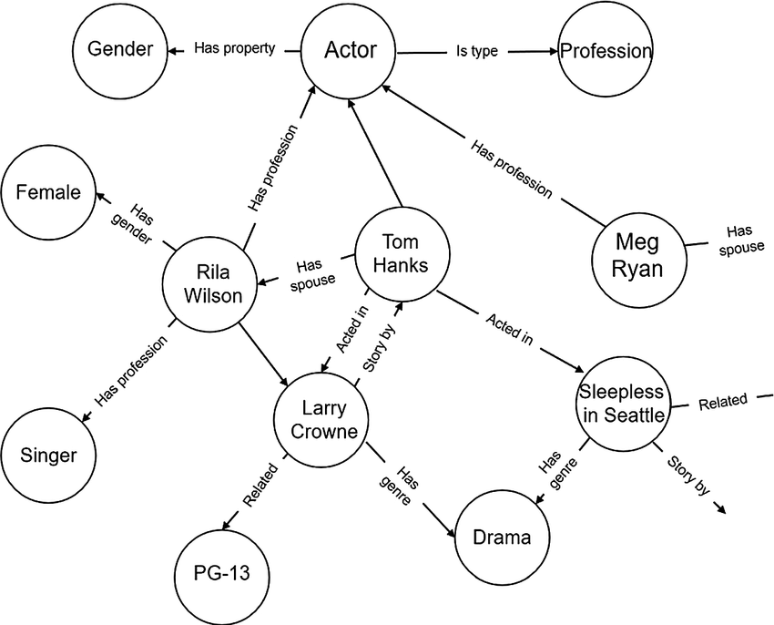
Methodology
Website pages – Unstructured data
(https://)
Web Scraping
Structured data
Storage Format
Data Cleaning
Knowledge graph construction

Slide 14
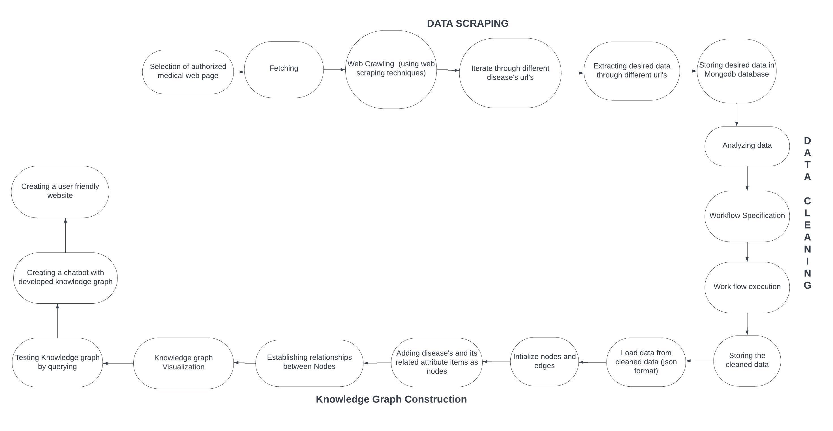
Work Flow

Slide 15
Data Scraping
To build a comprehensive medical knowledge graph, an essential step is to gather relevant data from various sources through data scraping. The process involves extracting structured and unstructured information from trusted medical websites.
Identifying Data Sources
Designing Web Scraping Strategies
Implementing Data Scraping
Data Transformation and Storage in MongoDB
Website : https://medlineplus.gov/healthtopics.html

Slide 16
Data Cleaning
It is the process of finding and removing errors, inconsistencies, duplications, and missing entries from data to increase data consistency and quality.
Understanding data set
Identify redundancies and inconsistences
Data cleaning techniques
a) Removing irrelevant data
b) Remove duplicates
c) Remove special symbols
d) Remove additional spaces

Slide 17
Knowledge Graph Construction
Knowledge graphs organize data into interconnected nodes representing entities and relationships, creating a semantic structure. This allows chatbots to comprehend context, infer meaning, and provide more accurate and context-aware responses.

Slide 18
Traversing

Slide 19
Breadth First Search Algorithm
Step 1: SET STATUS = 1 (ready state) for each node in G
Step 2: Enqueue the starting node A and set its STATUS = 2 (waiting state)
Step 3: Repeat Steps 4 and 5 until QUEUE is empty
Step 4: Dequeue a node N. Process it and set its STATUS = 3 (processed state).
Step 5: Enqueue all the neighbours of N that are in the ready state (whose STATUS = 1) and set their STATUS = 2 (waiting state)
[END OF LOOP]
Step 6: EXIT

Slide 20
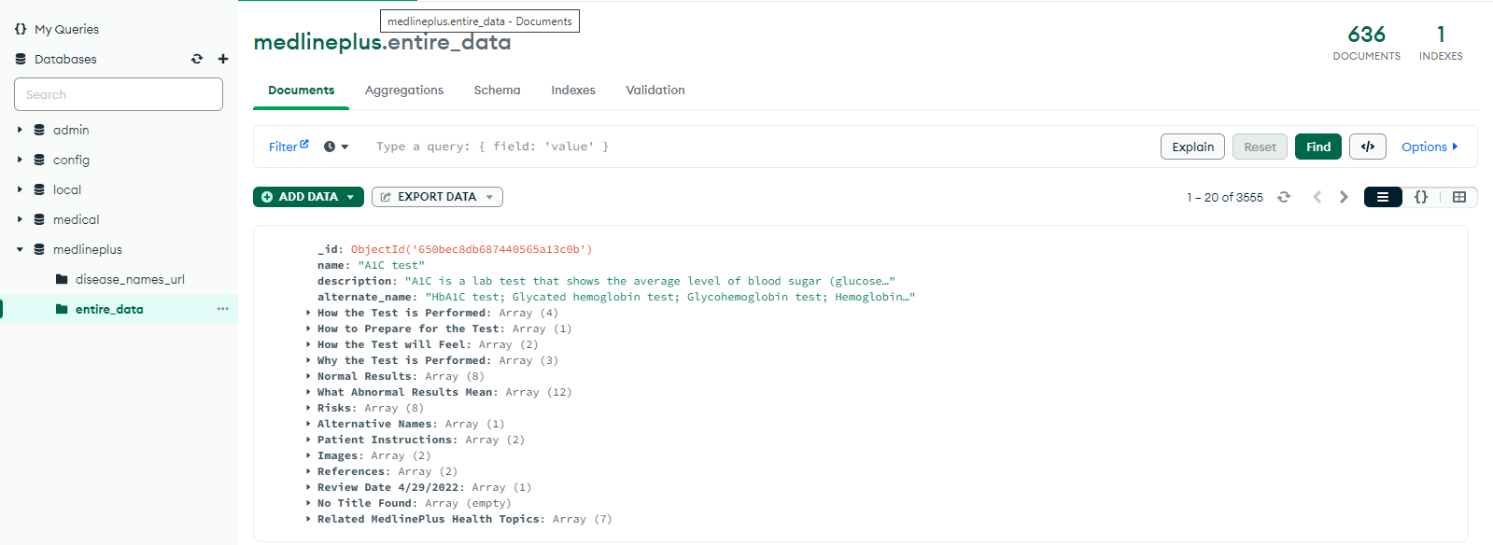
Results
Scraped data:

Slide 21
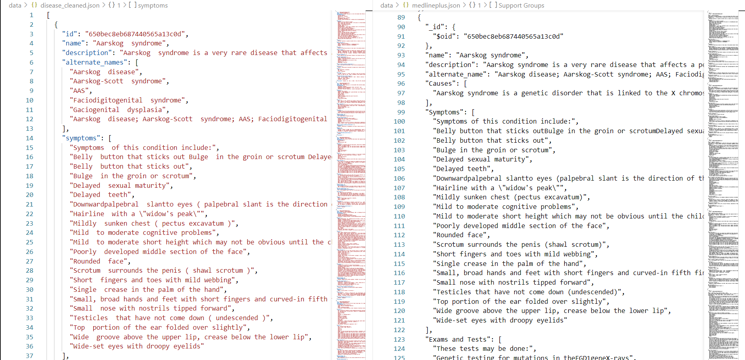
Cleaned data :-

Slide 22
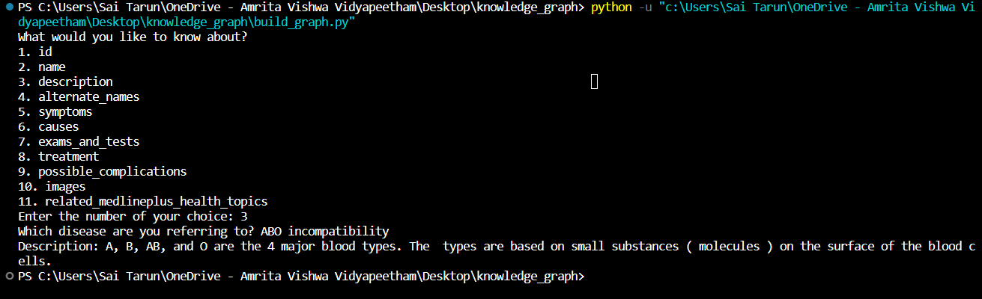
Querying :-

Slide 23
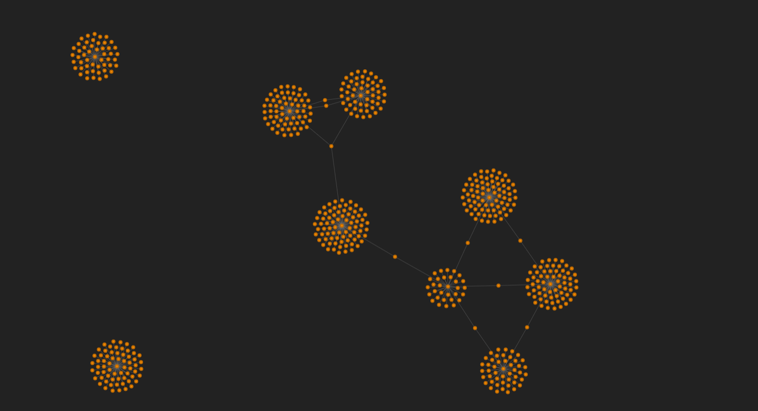
Knowledge graph visualization :-

Slide 24
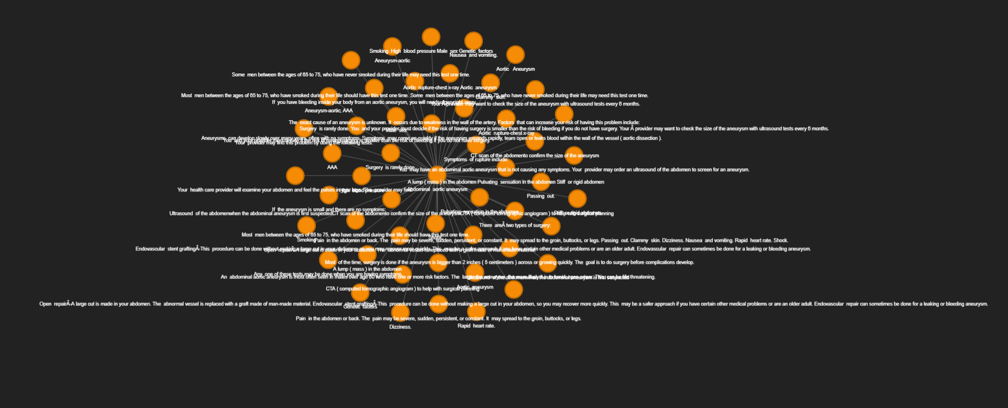
Node and edges (Single Node):-

Slide 25
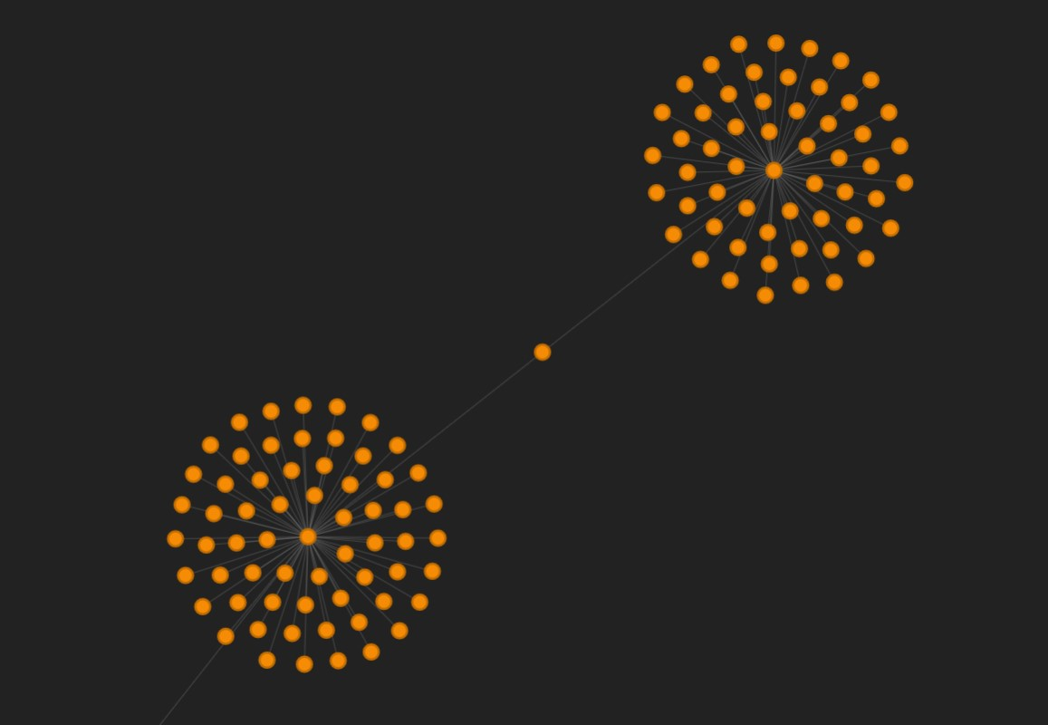
Two diseases with common attribute:

Slide 26
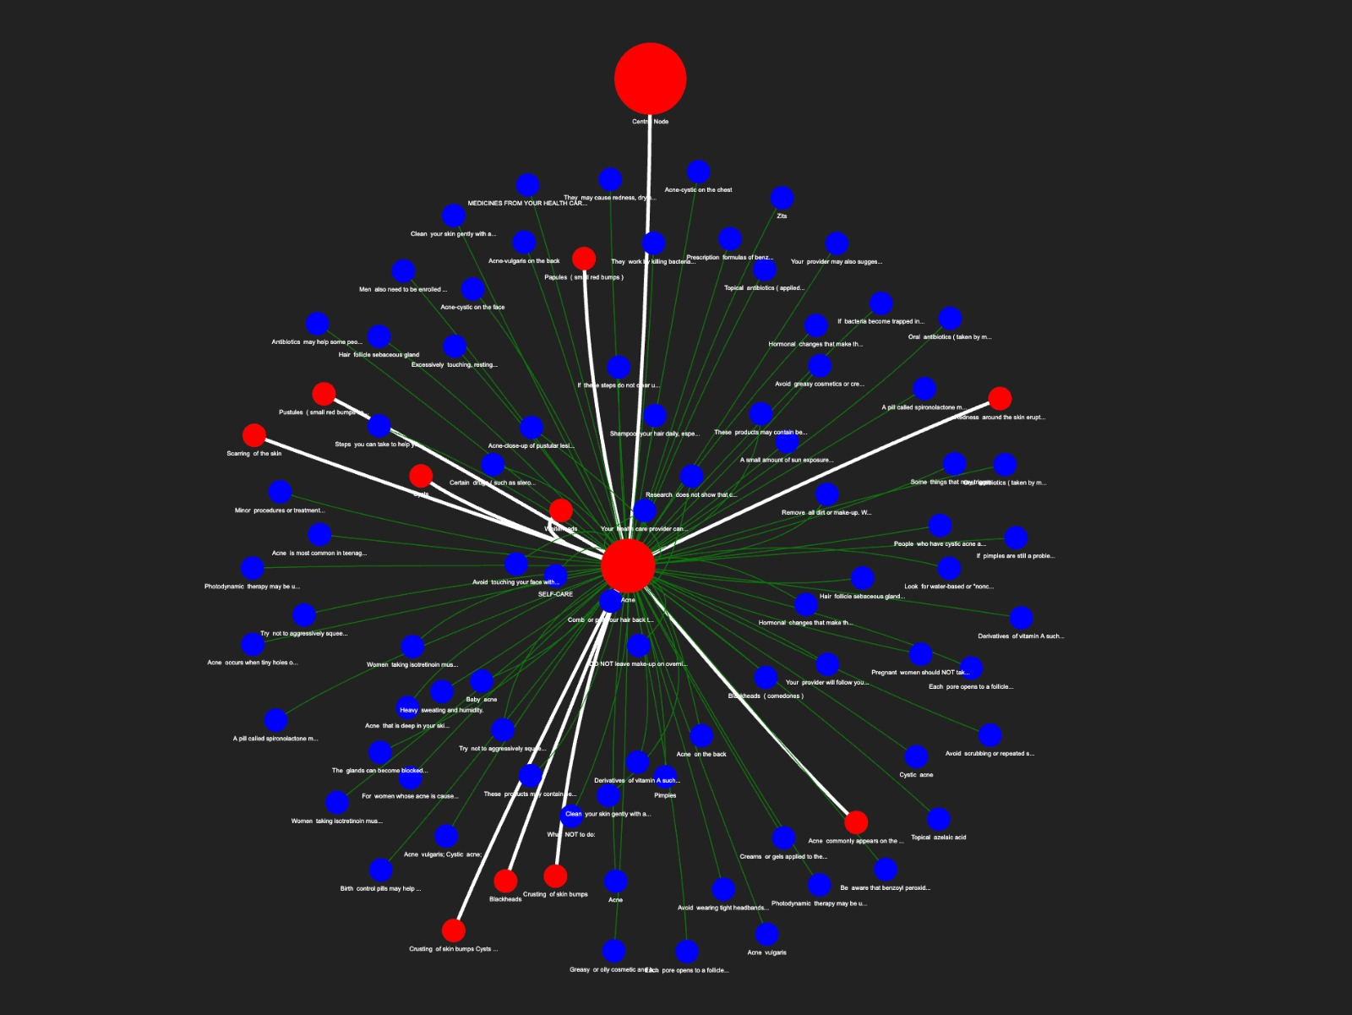
Traversal results:

Slide 27
Bibliography
[1]. E. Uzun, "A Novel Web Scraping Approach Using the Additional Information Obtained From Web Pages," in IEEE Access, vol. 8, pp. 61726-61740, 2020, doi: 10.1109/ACCESS.2020.2984503.
[2]. H. Lan et al., "COVID-Scraper: An Open-Source Toolset for Automatically Scraping and Processing Global Multi-Scale Spatiotemporal COVID-19 Records," in IEEE Access, vol. 9, pp. 84783-84798, 2021, doi: 10.1109/ACCESS.2021.3085682.
[3]. S. Ji, S. Pan, E. Cambria, P. Marttinen and P. S. Yu, "A Survey on Knowledge Graphs: Representation, Acquisition, and Applications," in IEEE Transactions on Neural Networks and Learning Systems, vol. 33, no. 2, pp. 494-514, Feb. 2022, doi: 10.1109/TNNLS.2021.3070843.
[4]. Jiang, Zhixue, Chengying Chi, and Yunyun Zhan. "Research on medical question answering system based on knowledge graph." IEEE Access 9 (2021): 21094-21101
[5]. Lino Murali, G. Gopakumar, Daleesha M. Viswanathan, Prema Nedungadi,Towards electronic health record-based medical knowledge graph construction, completion, and applications: A literature study,Journal of Biomedical Informatics,Volume 143,2023,104403,ISSN 1532-0464
[6]. Y. Lan, G. He, J. Jiang, J. Jiang, W. X. Zhao and J. -R. Wen, "Complex Knowledge Base Question Answering: A Survey," in IEEE Transactions on Knowledge and Data Engineering, vol. 35, no. 11, pp. 11196-11215, 1 Nov. 2023, doi: 10.1109/TKDE.2022.3223858.

Slide 28
Bibliography
[7]. D. N. and N. P. K. S., "Design and Development of We-CDSS Using Django Framework: Conducing Predictive and Prescriptive Analytics for Coronary Artery Disease," in IEEE Access, vol. 10, pp. 119575-119592, 2022, doi: 10.1109/ACCESS.2022.3220899.
[8]. S. Aghaei, E. Raad and A. Fensel, "Question Answering Over Knowledge Graphs: A Case Study in Tourism," in IEEE Access, vol. 10, pp. 69788-69801, 2022, doi: 10.1109/ACCESS.2022.3187178.
[9]. X. Wu, T. Jiang, Y. Zhu and C. Bu, "Knowledge Graph for China's Genealogy11.A shorter version of this paper won the Best Paper Award at IEEE ICKG 2020 (the 11th IEEE International Conference on Knowledge Graph, ickg 2020.bigke.org).," in IEEE Transactions on Knowledge and Data Engineering, vol. 35, no. 1, pp. 634-646, 1 Jan. 2023, doi: 10.1109/TKDE.2021.3073745.
[10]. Fakhare Alam, Hamed Babaei Giglou, Khalid Mahmood Malik,Automated clinical knowledge graph generation framework for evidence based medicine,Expert Systems with Applications,Volume 233,2023,120964,ISSN 0957-4174.

Slide 29
THANK YOU

